Slide 1

Factory System Performance Management (FSPM).
PRESENTED BY
NAME : ADITHYAN T S
SEMESTER/BRANCH : S6/MCA
UNIVERSITY NUMBER : LLMC17MCA007
PROJECT TYPE : MAIN PROJECT
(FINAL YEAR)
Under the Guidance of,
Prof. Anjana J, (Internal Supervisor)
Assistant Professor,
Department of Computer Application,
Lourdes Matha College of Science and
Technology, Kuttichal,Thiruvananthapuram

Slide 2
CONTENTS
ABSTRACT
EXISTING SYSTEM
PROPOSED SYSTEM
OPERATING ENVIRONMENT
MODULES AND ITS DESCRIPTION
DATA FLOW DIAGRAM
DATABASE AND ITS TABLES
PROJECT SCREENSHOT
FUTURE ENHANCMENT
CONCLUSION
REFERENCE

Slide 3
ABSTRACT
When it comes to industrial assets, performance and risk go hand in hand. You need confidence that any threats to productivity, safety and the environment are under control.
Factory System Performance Management (FSPM) software that helps you mitigate operational risk and confidently respond to today’s production challenges.
FSPM comes equipped with a library of pre configured risk analysis and asset reliability models and templates, based on decades of asset failure data, risk avoidance recommendations and industrial operations expertise.
FSPM gives you more assured insights of your operations and the health of your assets, helping you to dramatically cut operating costs, increase reliability and availability and reduce the risk of asset failures.

Slide 4
EXISTING SYSTEM
It is very time consuming to manage the necessary activity schedule of various operation and maintenance works in the factory.
It is difficult to calculate or keep track of the amount of work done, make records of , and retrieve previous records.
The existing system is very costly and time consuming, so computerization is inevitable.
Need to automate message sending process using a system generated email.
They should be able to monitor the inventory level, performance of employees, performance of machines and finally to take actions towards reducing the waste and machine down times to increase performance of the overall factory.

Slide 5

Cont.. EXISTING SYSTEM
Maintenance data are not effective :Current systems don’t have a way of tracking breakdowns happened earlier and machine down times of machines immediately.
Data entry is not dynamic ant flexible as required because all of the data related to a job cannot be entered at once since the events are happening at different times.

Slide 6
PROPOSED SYSTEM
Factory System Performance Management (FSPM) software that helps you mitigate operational risk and confidently respond to today’s production challenges.
Increase asset uptime by at least 20%, More than have inspection and maintenance costs.
It reduce equipment failure by as much as 95%.
Equipment breakdowns in manufacturing cost time, work hours, and resources. Our FSPM system can help reduce these unexpected and unnecessary losses.

Slide 7
Cont.. PROPOSED SYSTEM
Only users with rights are allowed to add or alter the information present and hence information authenticity is maintained.
Reduced amounts of machinery failures – equipment problems will be detected and will receive maintenance before they turn into expensive issues.
Dynamic tracing of the status of maintenance, depending on whether the maintenance action is planned or performed.
Due to the comprehensive nature of the system, the proposed system becomes the backbone for manufacturers to monitor, track, trace, and communicate business and manufacturing activities and data throughout the supply chain.

Slide 8
OPERATING ENVIRONMENT
HARDWARE REQUIREMENTS
Processor : Intel Core I5
RAM : 8 GB
Hard Disk : 256GB
Drives : 1.44MB Floppy Disk Drive, CD ROM , C-type Port
Display Size : Compatible Size(Recommend 15’inch)
Screen Resolution : 1080p image resolution
Keyboard : PC/AT Enhanced Type
Mouse : Logitech PS/2 Port Mouse
Monitor : SVGA color monitor

Slide 9
Cont.. OPERATING ENVIRONMENT
SOFTWARE REQUIREMENTS
Operating System : Windows/Ubuntu
Programming Language : Python
IDE : Pycharm, Visual Studio Code
Scripting Languages : HTML, CSS, Javascript
Web Browser : Google Chrome, FireFox
Front-End : Python , Django
Back-End : My SQL

Slide 10

MODULES
MACHINE MANAGEMENT
Common Machine Systems:
Equipment Machine Systems
Equipment Operation Management
Equipment Service Management
INVENTORY MANAGEMENT
AI BASED EFFICENCY MANAGEMENT

Slide 11
Machine Management
Machine is the device that comprises of the stationary parts and moving parts combined together to generate, transform or utilize the mechanical energy.
Each element in turn can be a complete part or made up of several small pieces which are joined together by riveting, welding etc.
Several machine parts are assembled together to form what we call as complete machine.
In a factory there can be different types of machines to operate ,the machine management system deals with management of these machines.

Slide 12

The sub modules of this machine system are:
Common Machine Systems:
In this module we create common machine system with common features .Example of common system are power system,fire system etc
Equipment Machine Systems :
This module creates equipments( machines used in factory) ,with its property and features.this module specifies unique features of the equipment

Slide 13
Equipment Operation Management:
It includes entire operation management of the equipment.
Equipment Service Management:
Automated Notification(Scheduled maintenance) : Maintenance Due Notices are automatically generated at check-in when a item becomes due for scheduled maintenance.
Unscheduled maintenance :The System gives a better picture parts and also tracking and monitoring of unscheduled repair tasks.
Maintenance History : . In this feature users can access all the information they need very quickly. Maintenance plans, tools management, tasks history.

Slide 14
INVENTORY MANAGEMENT
This module provides centralization of your most basic and necessary warehouse functions.
Data syncs to all other parts of your system, so all your functions can run using the same information.
Raw material inventory is the total cost of all the parts you have in stock, but not yet used in production. There are two types of raw materials: direct and indirect materials.

Slide 15
Indirect materials Management system
Indirect inventory refers to materials that are not directly used in a final product.
Indirect materials can also include supplies called maintenance, repair, and operations supplies that are used to maintain and repair a company’s plant and equipment such as those used to manufacture a company’s products.
This supplier management solution provides supplier management tools needed to perform supplier evaluation and selection, and subsequent maintenance of your suppliers and the products approved for purchase from those suppliers.

Slide 16
AI BASED EFFICENCY MANAGEMENT
Algorithms using are:
Random forest regression
SVR
Prediction for performance of equipments based on machine learning using algorithm support vector regression.
Overall prediction of performance can be calculated for all common system .
Each individual equipment system performance can also generated.
Can predict Number of parts need to be replaced for selected feature year using algorithm randomforest regression.
Machine learning library – scikitlearn

Slide 17
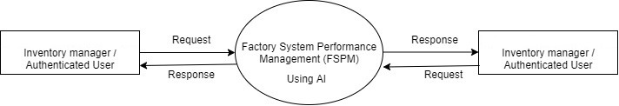
DATA FLOW DIAGRAM (DFD)
Level 0 (Context Level):

Slide 18
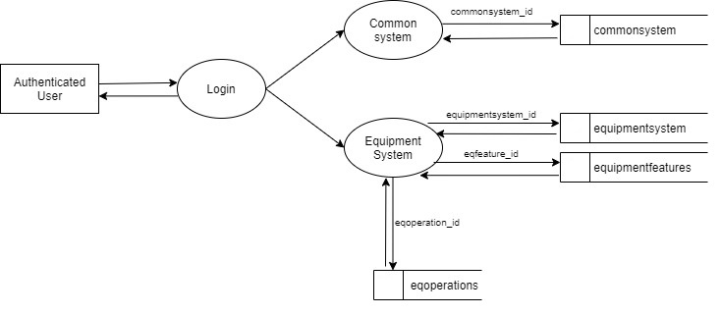
DFD of Common Machine System Level 1 of Common Machine System

Slide 19
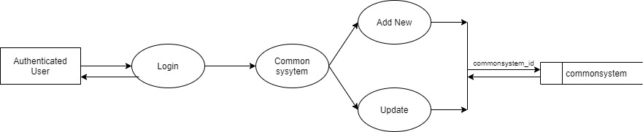
Level 1.1 of Equipment Machine System

Slide 20
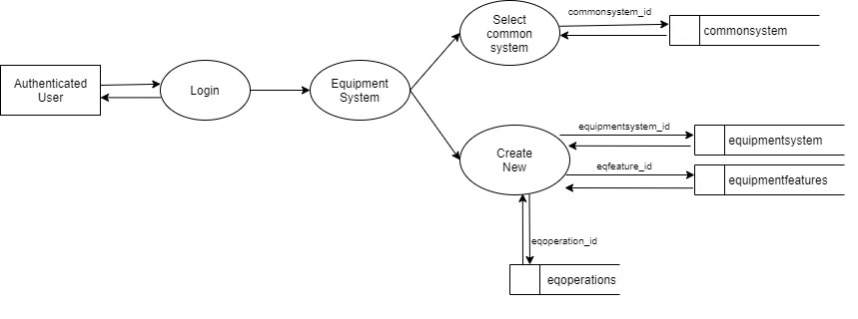
Level 1.2 of Equipment Machine System

Slide 21
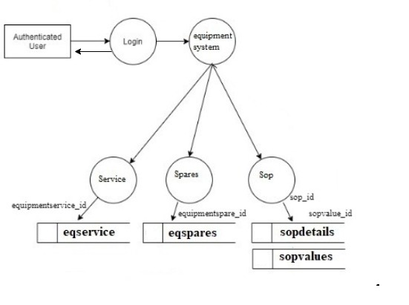
Level 1.3 of Equipment Machine System

Slide 22
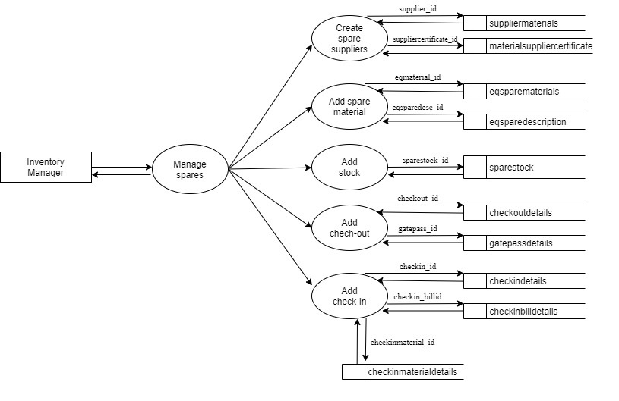
Inventory Level 1 of Inventory management

Slide 23
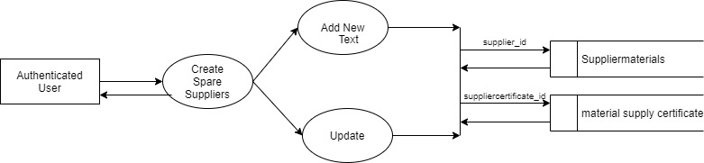
Level 1.1 of Inventory management: create supplier

Slide 24
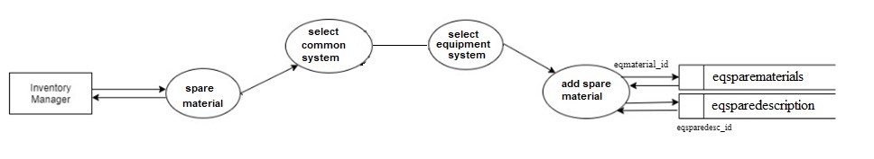
Level 1.2 of Inventory management: Add spare material type

Slide 25
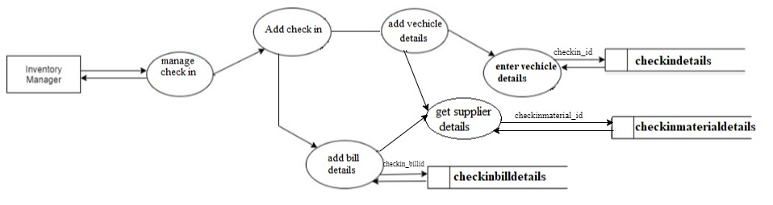
Level 1.3 of Inventory management: Add Check in

Slide 26
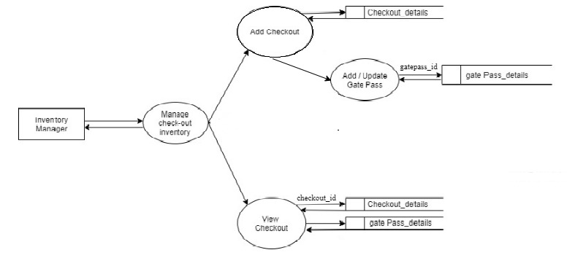
Level 1.4 of Inventory management: Add Check Out

Slide 27
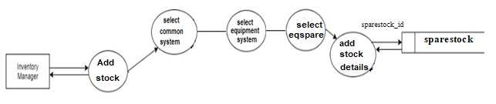
Level 1.5 of Inventory management: Add Stock

Slide 28
MACHINE MANAGEMENT Add common system
Table Name: commonsystem Primary Key: commonsystem_id
Description: Details of commonsystem
Field | Data Type | Size | Constraint | Description
commonsystem_id | Integer | 10 | Primary key | Id of common system
commonsystem_name | Varchar | 20 |  | Name of common system
commonsystem_desc | Text |  |  | Description of common system
commonsystem_type | Varchar | 20 |  | Type of common system
commonsystem_category | Varchar | 20 |  | Category of common system
commonsystem_moredesc | Text |  |  | More description of common system
commonsystem_fuction | Text |  |  | Function of common system
image_name | Varchar | 20 |  | Name of image
image_path | Varchar | 20 |  | Path of image
image_type | Varchar | 20 |  | Type of image
image_date | Timestamp |  |  | Date of image
properties_name | Varchar | 20 |  | Name of properties
properties_value | Varchar | 20 |  | Value of properties
properties_desc | Text |  |  | Description of properties
properties_type | Varchar | 10 |  | Type of properties

Slide 29
ADD EQUIPMENT SYSTEM TABLES USED: equipmentsystem,equipmentfeatures,eqoperations
Table Name: equipmentsystem Primary Key: equipmentsystem_id
Description: Details of equipmentsystem
Field | Data Type | Size | Constraint | Description
equipmentsystem_id | Integer | 10 | Primary key | Id of equipment system
commonsystem_id | Integer | 10 | Foreign key | Id of common system
equipmentsystem_name | Varchar | 20 |  | Name of equipment system
equipmentsystem_desc | Text |  |  | Description of equipment system
equipmentsystem_category | Varchar | 20 |  | Category of equipment system
equipmentsystem_moredesc | Text |  |  | More description of equipment system
equipmentfeature_id | Integer | 10 | Foreign key | Id of equipment feature

Slide 30
Table Name: equipmentfeatures Primary Key: eqfeature_id
Description: Details of equipment features
Field | Data Type | Size | Constraint | Description
eqfeature_id | Integer | 10 | Primary key | Id of equipment feature
equipmentsystem_id | Integer | 10 | Foreign key | If of equipment system
eqfeature_name | Varchar | 20 |  | Name of equipment feature
eqfeature_desc | Text |  |  | Description of equipment feature
eqfeature_operationname | Varchar | 20 |  | Operation name of equipment feature
eqfeature_moredesc | Text |  |  | More description of equipment feature
Table Name: eqoperation Primary Key: eqoperation_id
Description: Details of equipmentoperation
Field | Data Type | Size | Constraint | Description
eqoperation_id | Integer | 10 | Primary key | Id of equipment operation
eqparameter_name | Varchar | 20 |  | Name of equipment parameter
eqparameter_value | Varchar | 20 |  | Value of equipment parameter
eqoperation_samplevalue | Varchar | 20 |  | Sample value of equipment operation
equipmentsystem_id | Integer | 10 | Foreign key | Id of equipment system

Slide 31
Add Equipment Services
Table Name: eqservice Primary Key: equipmentservice_id
Description: Details of equipmentservice
Field | Data Type | Size | Constraint | Description
equipmentservice_id | Integer | 10 | Primary key | Id of equipment service
equipmentservice_name | Varchar | 20 |  | Name of equipment service
equipmentservice_lastdate | Date |  |  | Last date of equipment service
equipmentservice_nextdate | Date |  |  | Next date of equipment service
equipmentservice_note | Text |  |  | Note of equipment service
equipmentservice_desc | Text |  |  | Description of equipment service
equipmentsystem_id | Integer | 10 | Foreign key | Id of equipment system
equipmentservice_type | Varchar | 20 |  | Type of equipment service
equipmentservice_path | Varchar | 30 |  | Path of equipment service
equipmentservice_date | Date |  |  | Date of equipment service

Slide 32
Add spares
Table Name: eqspares Primary Key: equipmentspare_id
Description: Details of equipmentspare
Field | Data Type | Size | Constraint | Description
equipmentspare_id | Integer | 20 | Primary key | Id of equipment spare
equipmentspare_name | Varchar | 20 |  | Name of equipment spare
equipmentspare_category | Text |  |  | Category equipment spare
equipmentspare_type | Varchar | 20 |  | Type of equipment spare
equipmentspare_number | Integer | 20 |  | Number of equipment spare
equipmentspare_material | Varchar | 20 |  | Material of equipment spare
equipmentsystem_id | Integer | 10 | Foreign key | Id of equipment system

Slide 33
SOP Tables used: sopdetails, sopvalues
Table Name: sopdetails Primary Key: sop_id
Description: Details of sopdetails
Field | Data Type | Size | Constraint | Description
sop_id | Integer | 10 | Primary key | Id of sop
sop_name | Varchar | 20 |  | Name of sop
sop_desc | Text |  |  | Description of sop
sop_type | Varchar | 20 |  | Type of sop
equipmentsystem_id | Integer | 10 | Foreign key | Id of equipment system
Table Name: sopvalues Primary Key: sopvalue_id
Description: Details of sopvalues
Field | Data Type | Size | Constraint | Description
sopvalue_id | Integer | 10 | Primary key | Id of sop value
sop_parameter | Varchar | 20 |  | Parameter of sop
sop_name | Varchar | 20 |  | Name of sop
sop_type | Varchar | 20 |  | Type of sop
sop_value | Varchar | 20 |  | Value of sop
sop_unit | Varchar | 20 |  | Unit of sop
equipmentsystem_id | Integer | 10 | Foreign key | Id of equipment system

Slide 34
Inventory spare management add Supplier tables used: suppliermaterials, materialsuppliercertification
Table Name: materialsuppliercertificate Primary Key: suppliercertificate_id
Description: Details of material supplier certificate
Field | Data Type | Size | Constraint | Description
suppliercertificate_id | Integer | 10 | Primary key | Id of supplier certificate
supplier_id | Integer | 10 | Foreign key | Id of supplier
suppliercertificate_name | Varchar | 20 |  | Name of supplier certificate
suppliercertificate_type | Varchar | 20 |  | Type of supplier certificate
suppliercertificate_path | Varchar | 20 |  | Path of supplier certificate

Slide 35
Table Name: suppliermaterials Primary Key: supplier_id
Description: Details of suppliers materials
Field | Data Type | Size | Constraint | Description
supplier_id | Integer | 10 | Primary key | Id of supplier
supplier_name | Varchar | 20 |  | Name of supplier
supplier_category | Varchar | 20 |  | Category of supplier
supplier_mail | Varchar | 20 |  | Mail of supplier
supplier_phone | Integer | 15 |  | Phone number of supplier
supplier_mobile | Integer | 15 |  | Mobile number of supplier
supplier_contactperson | Varchar | 20 |  | Contact person of supplier
supplier_contactpersonmobile | Integer | 15 |  | Contact person mobile number of supplier
supplier_contactpersonemail | Integer | 20 |  | Contact person email of supplier
supplier_logo | blob |  |  | Logo of supplier
supplier_type | Varchar | 20 |  | Type of supplier
supplier_weburl | Varchar | 20 |  | Web url of supplier
supplier_address | Text |  |  | Address of supplier
supplier_regnum | Integer | 20 |  | Register number of supplier
supplier_taxnum | Integer | 20 |  | Tax number of supplier
supplier_latitude | Float | 15 |  | Latitude of supplier
supplier_longitude | Float | 15 |  | Longitude of supplier

Slide 36
Add Spare material
Table Name: eqsparematerials Primary Key: eqmaterial_id
Description: Details of eqsparematerials
Field | Data Type | Size | Constraint | Description
eqmaterial_id | Integer | 10 | Primary key | Id of equipment material
equipmentsystem_id | Integer | 10 | Foreign key | Id of equipment system
supplier_id | Integer | 10 | Foreign key | Id of supplier
eqmaterial_type | Varchar | 10 |  | Type of equipment material
eqmaterial_length | Varchar | 10 |  | Length of equipment material
eqmaterial_width | Varchar | 10 |  | Width of equipment material
eqmaterial_height | Varchar | 10 |  | Height of equipment material
eqmaterial_weight | Varchar | 10 |  | Weight of equipment material

Slide 37
ADD Stock
Table Name: sparestock Primary Key: sparestock_id
Description: Details of sparestock
Field | Data Type | Size | Constraint | Description
sparestock_id | Integer | 10 | Primary key | id of spare stock
supplier_id | Integer | 10 | Foreign key | Id of supplier
equipmentsystem_id | Integer | 10 | Foreign key | Id of equipment system
equipmentspare_id | Integer | 10 | Foreign key | Id of equipment spare
eqspare_manufacturedate | Date |  |  | Manufacture date of equipment spare
eqspare_purchasedate | Date |  |  | Purchase date of equipment spare
eqspare_packetquantity | Integer | 10 |  | Packet quantity of equipment spare
eqspare_packetcode | Integer | 10 |  | Packet code of equipment spare
eqspare_totalnum | Integer | 20 |  | Total number of equipment spare
eqspare_expirydate | Date |  |  | Expiry date of equipment spare
eqspare_imagepath | Varchar | 20 |  | Image path of equipment spare
eqspare_quantityunit | Smallint | 4 |  | Quantity unit of equipment spare

Slide 38
Add Check in Tables used: checkindetails, checkinbilldetails
Table Name: checkindetails Primary Key: checkin_id
Description: Details of checkin details
Field | Data Type | Size | Constraint | Description
checkin_id | Integer | 10 | Primary key | Id of checkin
checkin_date | Date |  |  | Date of checkin
checkin_time | Timestamp |  |  | Time of checkin
checkin_vehiclenum | Integer | 20 |  | Vehicle number of checkin
checkin_vehicletype | Varchar | 30 |  | Vehicle type of checkin
checkin_vehicleregno | Integer | 12 |  | Vehicle register number of checkin
checkin_vehicledrivermobile | Integer | 15 |  | Mobile number of vehicle driver
checkin_vehicledrivername | Varchar | 20 |  | Name of vehicle driver
checkin_vehiclephoto | Blob |  |  | Photo of vehicle
checkin_vehicleauthority | Varchar | 20 |  | Authority of vehicle
checkin_vehiclecategory | Varchar | 20 |  | Category of vehicle
checkin_desc | Text |  |  | Description of checkin

Slide 39
Table Name: checkoutdetails Primary Key: checkout_id
Description: Details of checkout details
Field | Data Type | Size | Constraint | Description
checkout_id | Integer | 10 | Primary key | Id of checkout
checkout_date | Date |  |  | Date of checkout
checkout_time | Timesptamp |  |  | Time of checkout
checkout_vehiclenum | Integer | 20 |  | Vehicle number of checkout
checkout_vehicletype | Varchar | 20 |  | Vehicle type of checkout
checkout_vehicleregno | Integer | 15 |  | Vehicle register number of checkout
checkout_vehicledrivermobile | Integer | 15 |  | Mobile number of vehicle driver
checkout_vehicledrivername | Varchar | 20 |  | Name of vehicle driver
checkout_vehiclephoto | Blob |  |  | Photo of vehicle
checkout_vehicleauthority | Varchar | 20 |  | Authority of vehicle
checkout_vehiclecategory | Varchar | 20 |  | Category of vehicle
checkout_desc | Text |  |  | Description of checkout

Slide 40
Add checkout Tables used: checkoutdetails, gatepassdetails
Table Name: checkoutdetails Primary Key: checkout_id
Description: Details of checkout details
Field | Data Type | Size | Constraint | Description
checkout_id | Integer | 10 | Primary key | Id of checkout
checkout_date | Date |  |  | Date of checkout
checkout_time | Timesptamp |  |  | Time of checkout
checkout_vehiclenum | Integer | 20 |  | Vehicle number of checkout
checkout_vehicletype | Varchar | 20 |  | Vehicle type of checkout
checkout_vehicleregno | Integer | 15 |  | Vehicle register number of checkout
checkout_vehicledrivermobile | Integer | 15 |  | Mobile number of vehicle driver
checkout_vehicledrivername | Varchar | 20 |  | Name of vehicle driver
checkout_vehiclephoto | Blob |  |  | Photo of vehicle
checkout_vehicleauthority | Varchar | 20 |  | Authority of vehicle
checkout_vehiclecategory | Varchar | 20 |  | Category of vehicle
checkout_desc | Text |  |  | Description of checkout

Slide 41
Table Name: gatepassdetails Primary Key: gatepass_id
Description: Details of gatepass
Field | Data Type | Size | Constraint | Description
gatepass_id | Integer | 10 | Primary key | Id of gatepass
gatepass_name | Varchar | 20 |  | Name of gatepass
gatepass_date | Date |  |  | Date of gatepass
gatepass_time | timestamp |  |  | Time of gatepass
gatepass_reason | Text |  |  | Reason for gatepass
gatepass_vehicleno | Integer | 12 |  | Vehicle number
gatepass_employeeid | Integer | 10 | Foreign key | Id of employee who get the gatepass

Slide 42
PROJECT SCREENSHOT’S

Slide 43
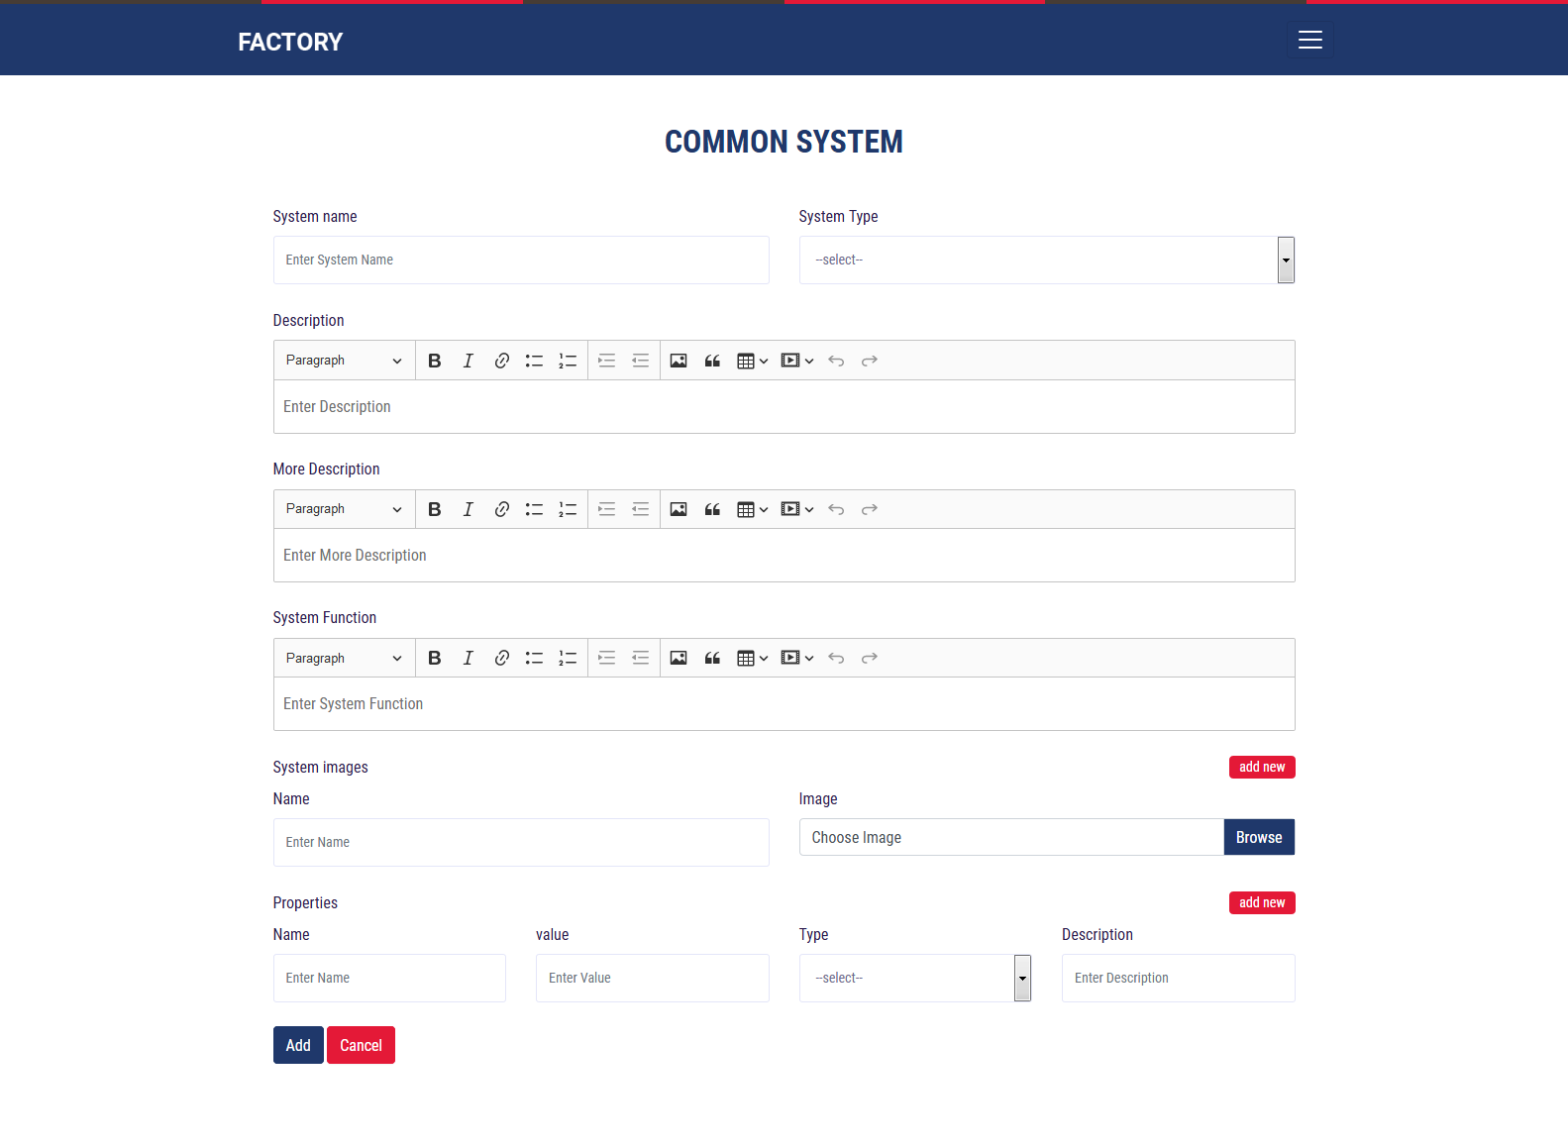
Machine Common System

Slide 44
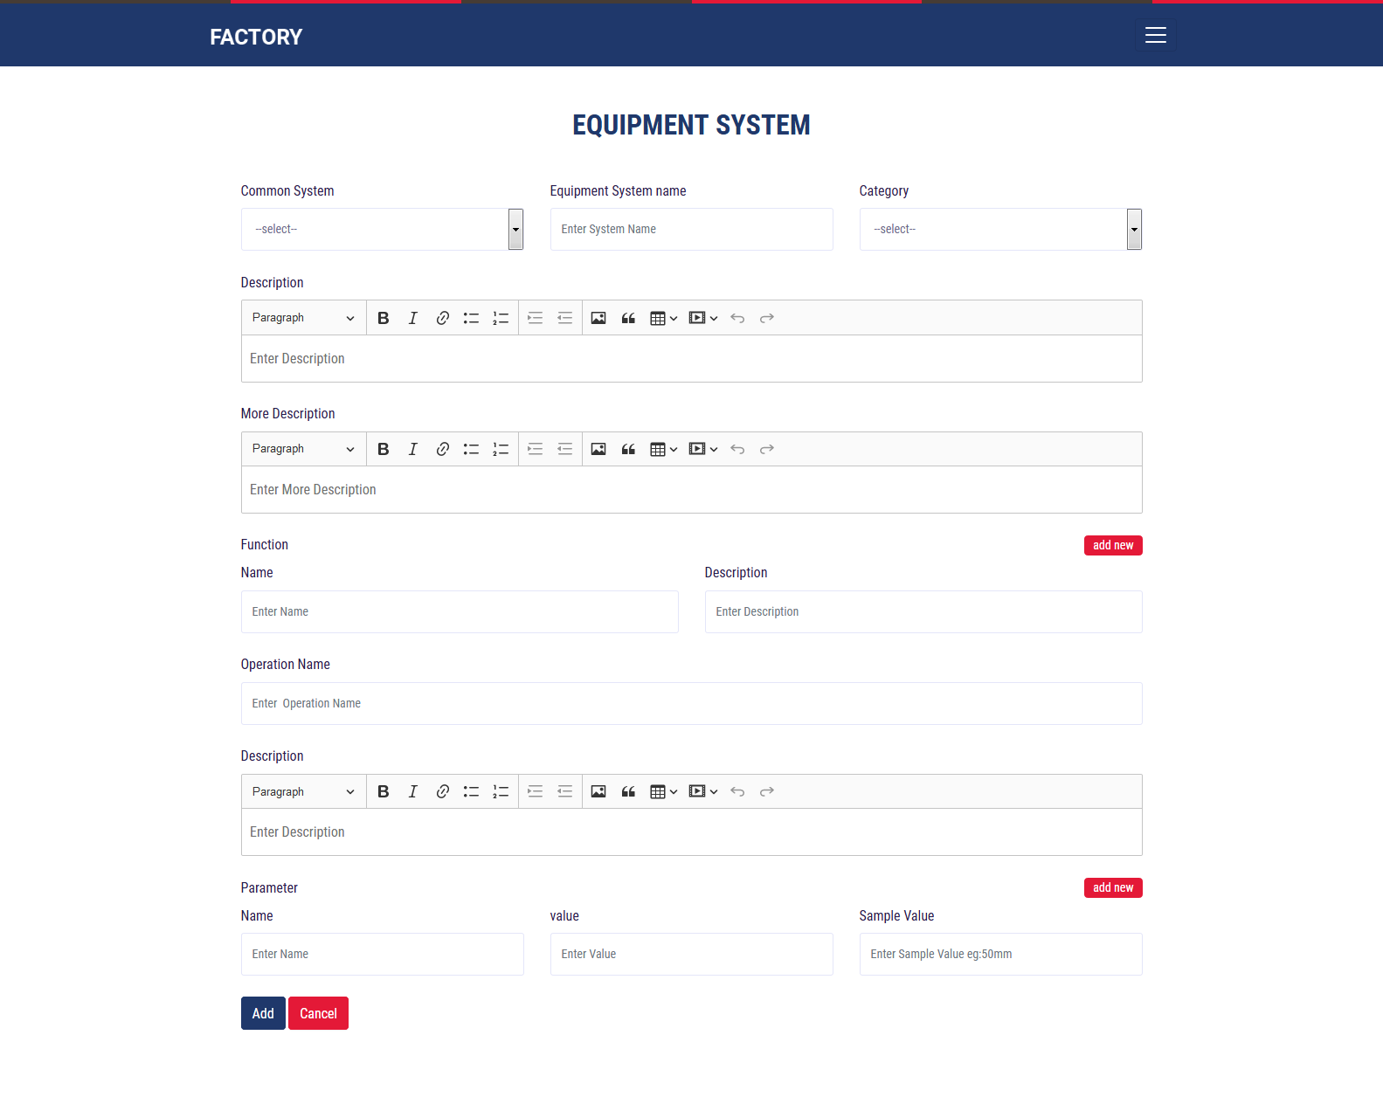
EQuipment System

Slide 45
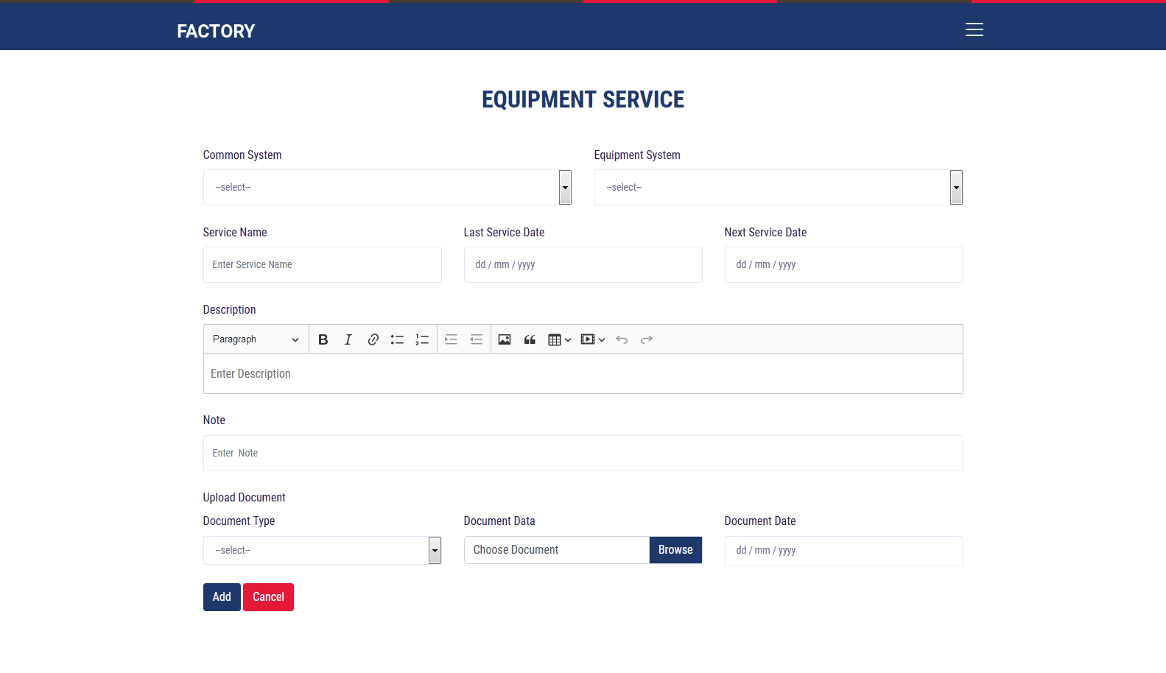
Service

Slide 46
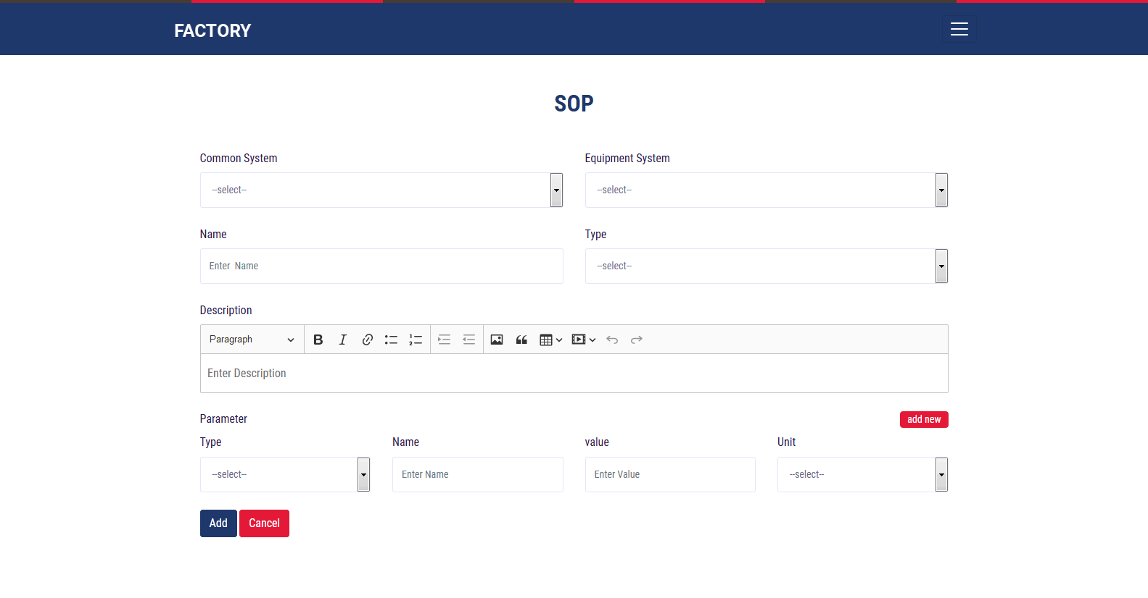
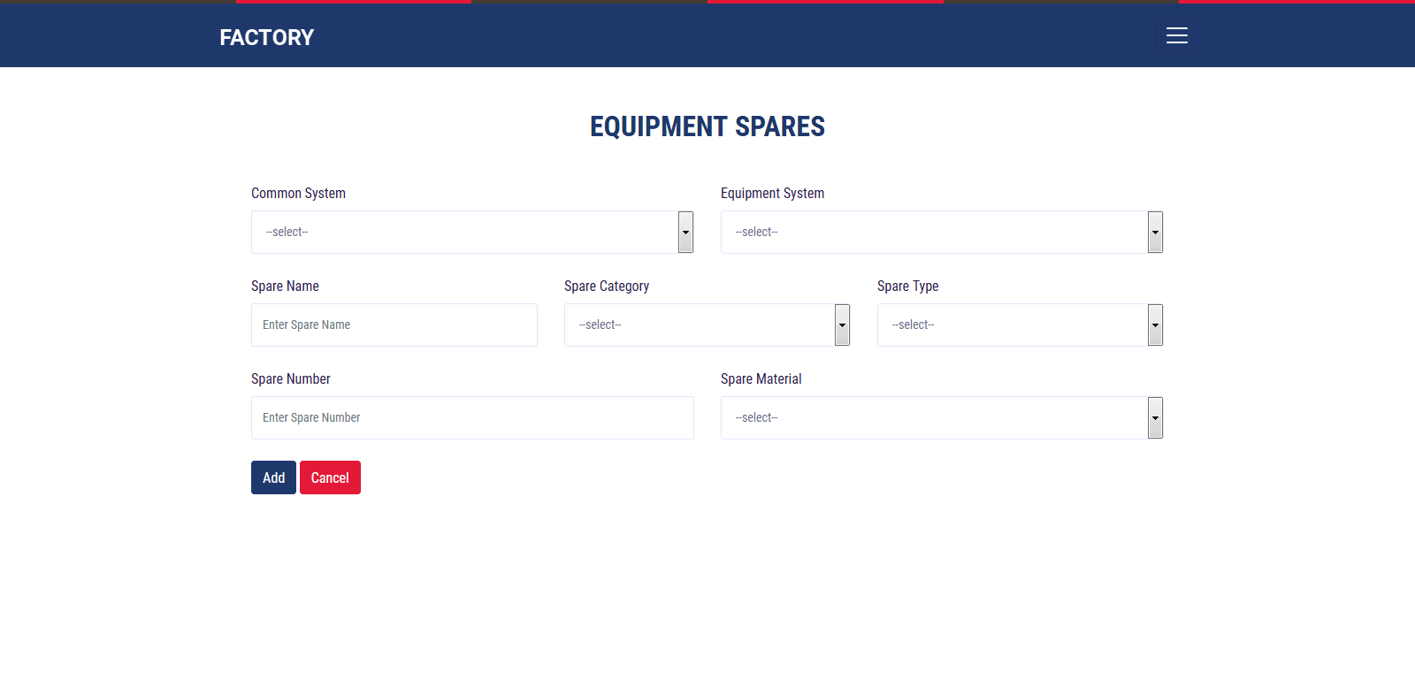
Sop-standard operating Procedure Spares

Slide 47
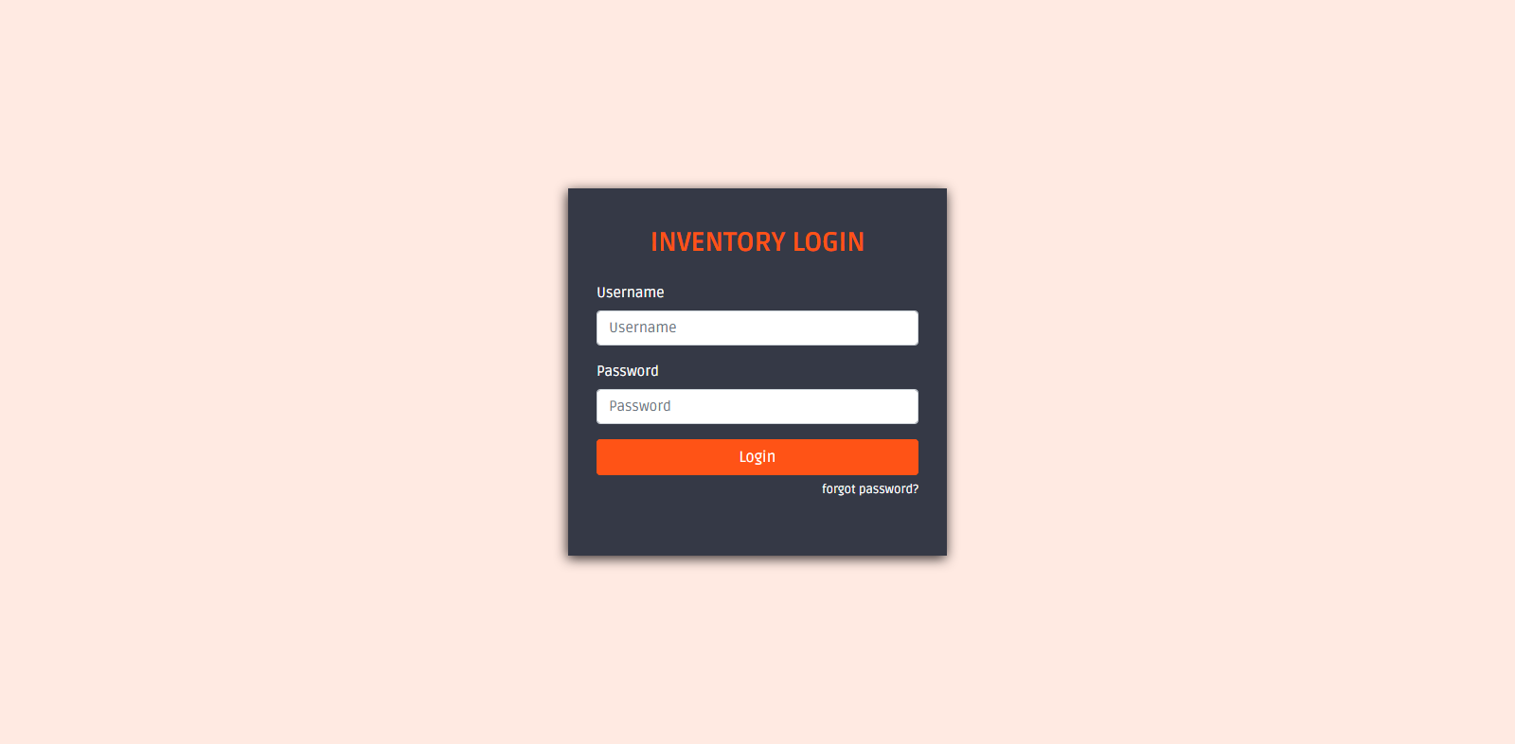

Inventory Login

Slide 48
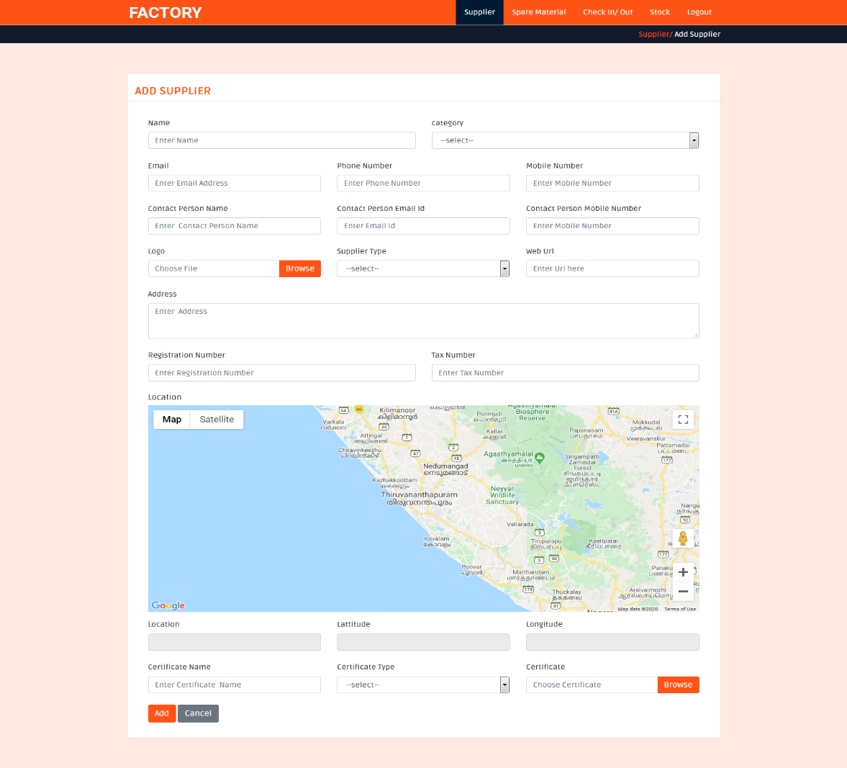
Add Supplier

Slide 49
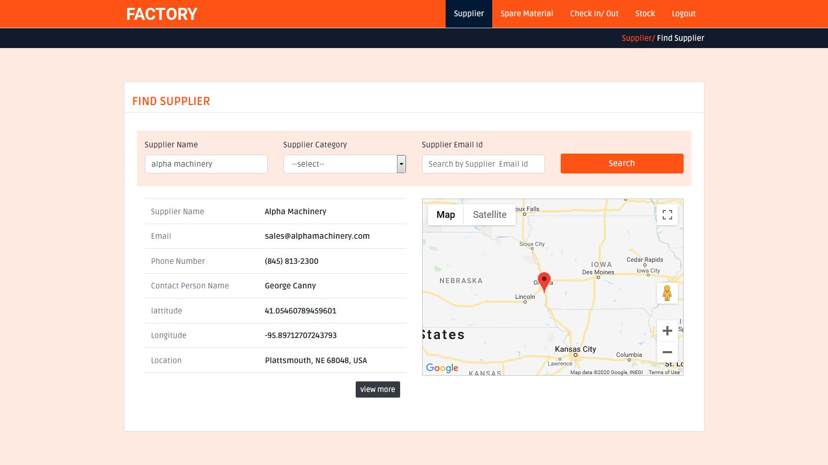
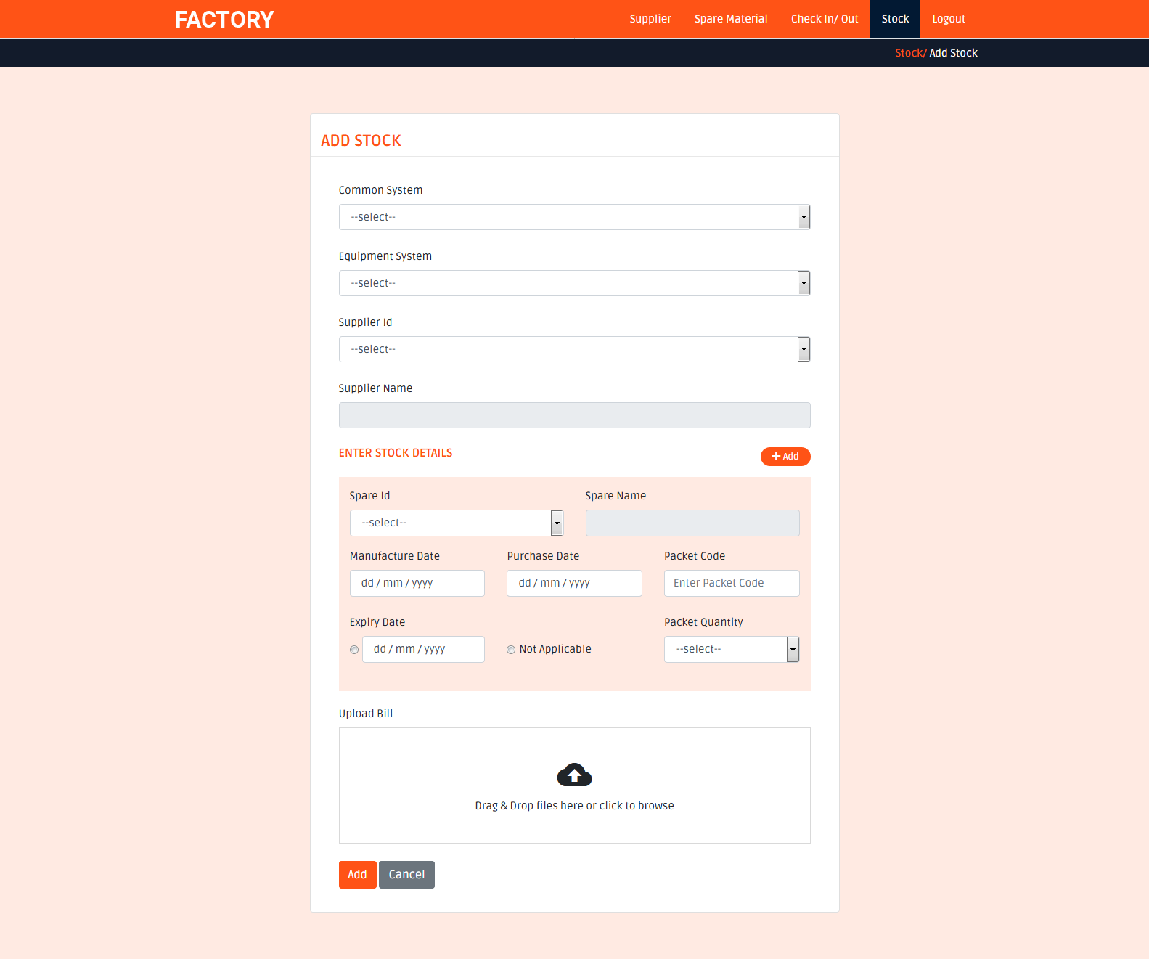
Find supplier Add Stock

Slide 50
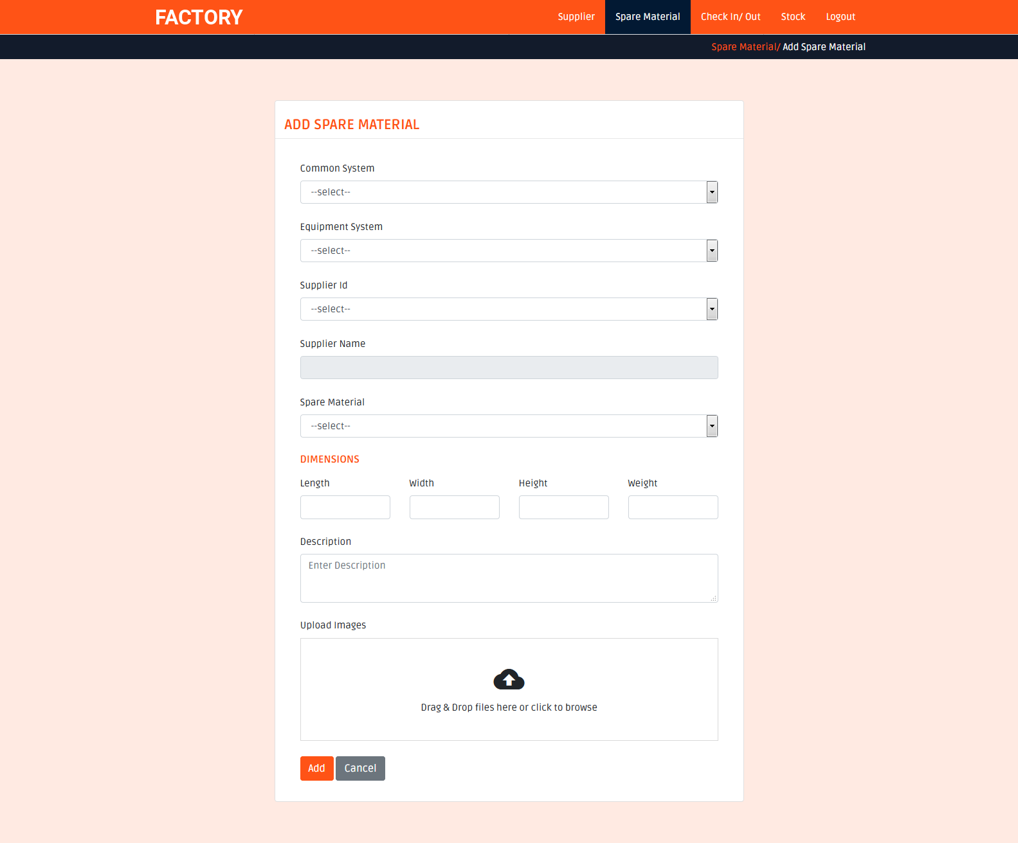
Add Spare Material

Slide 51
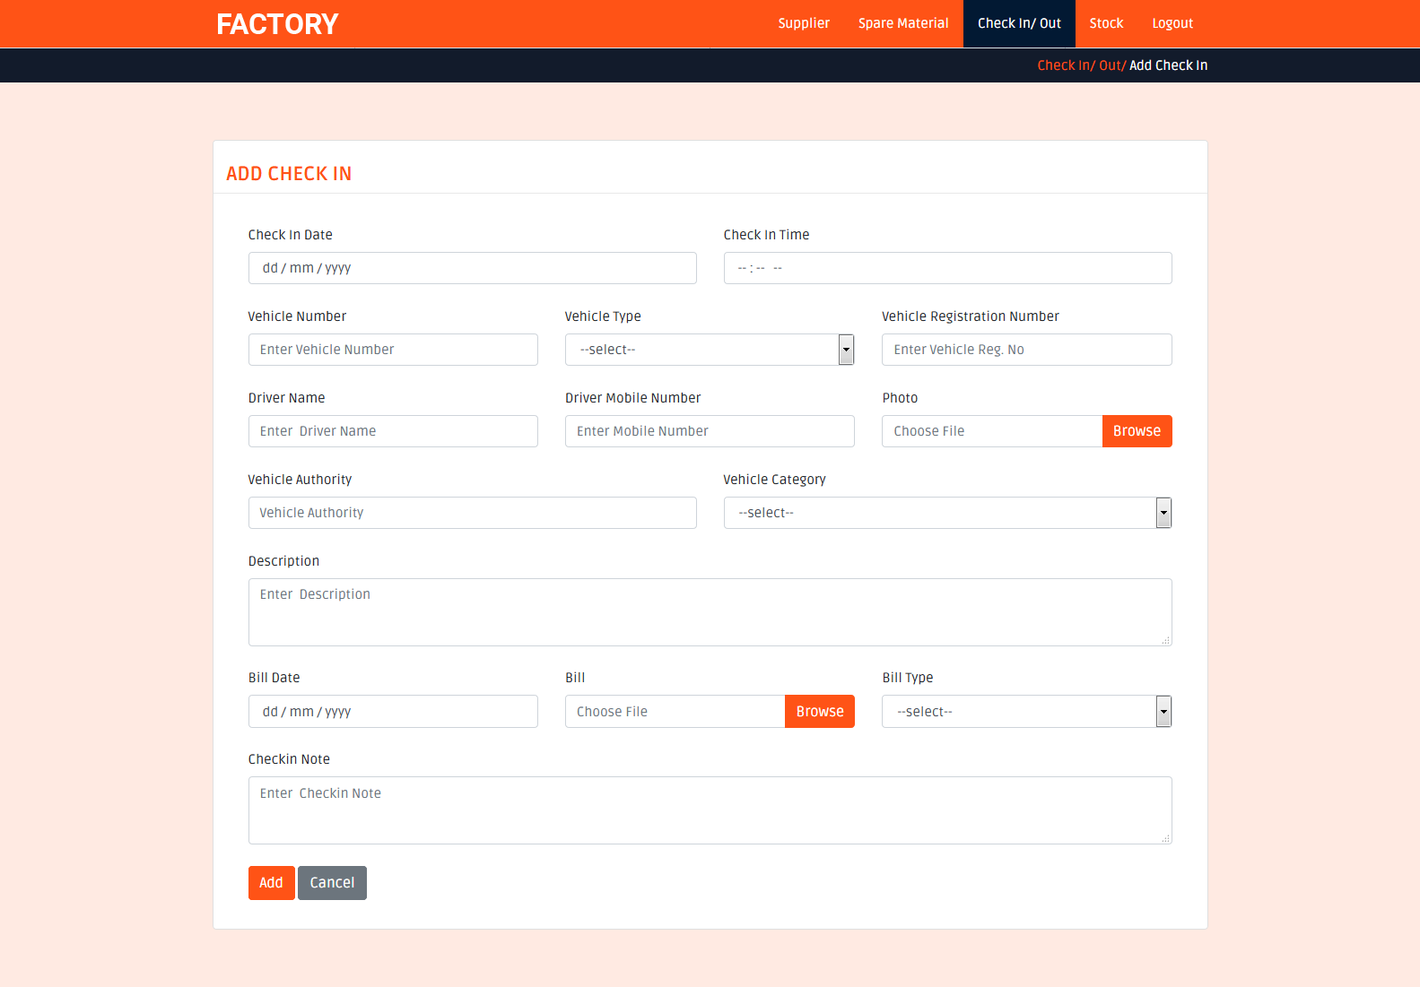
Add Check In

Slide 52
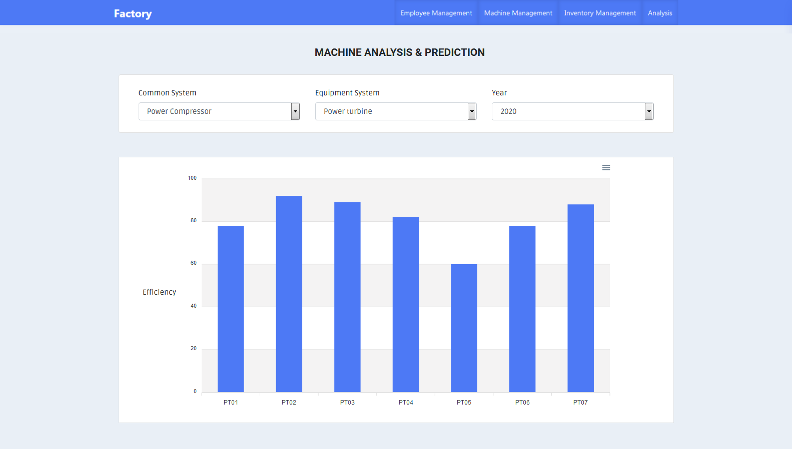
Analysis & prediction

Slide 53
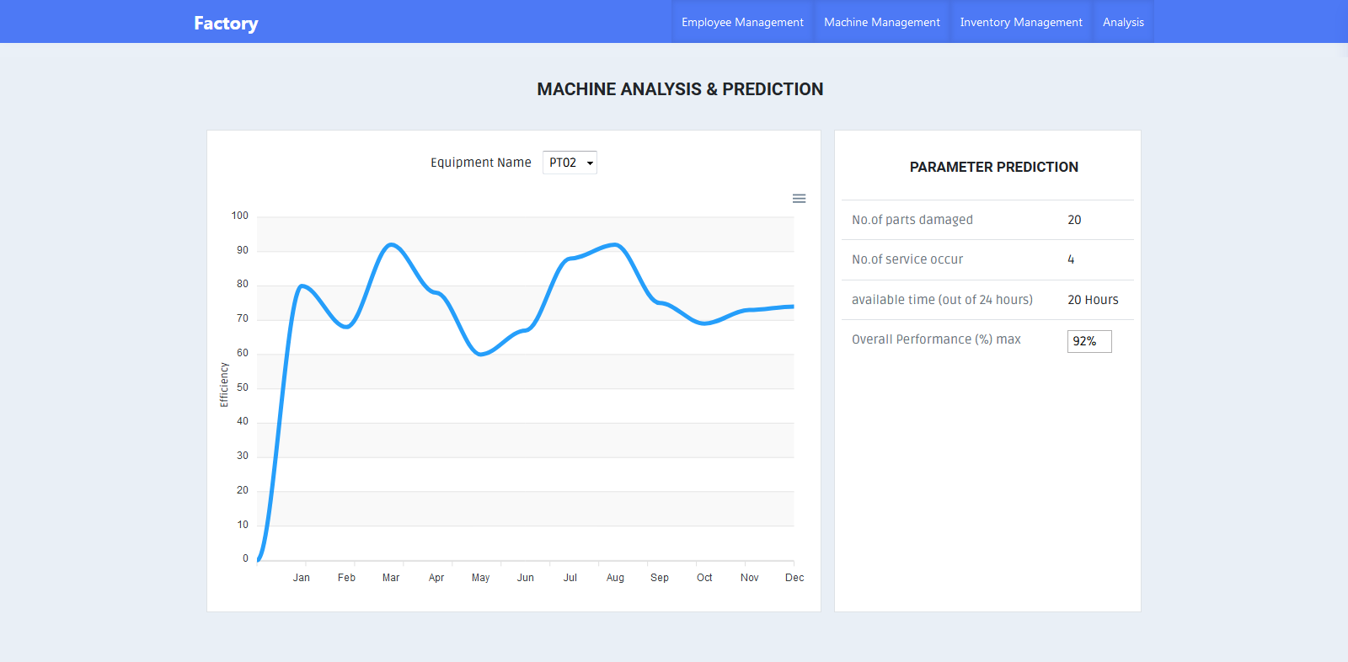
Parameter Prediction

Slide 54
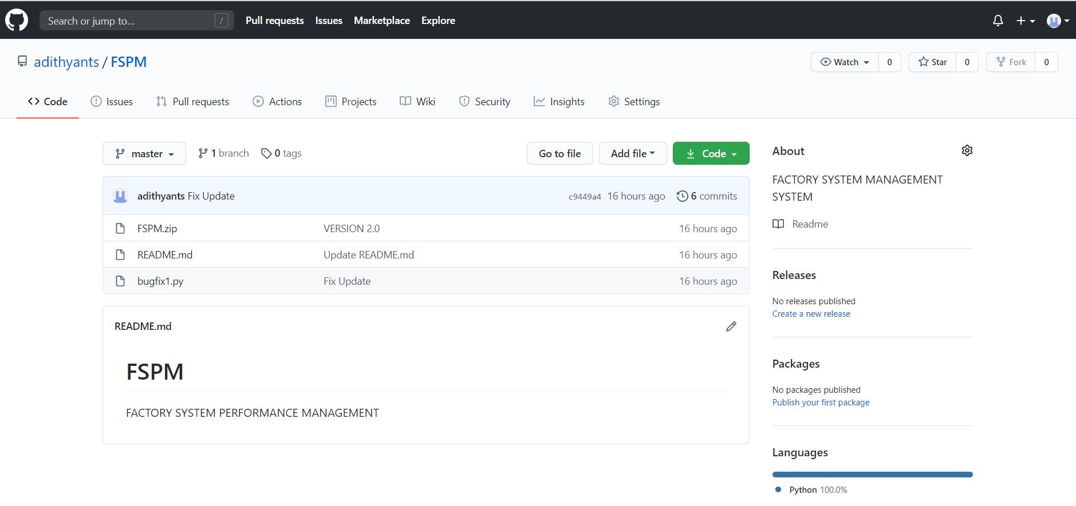
GIT HUB

Slide 55
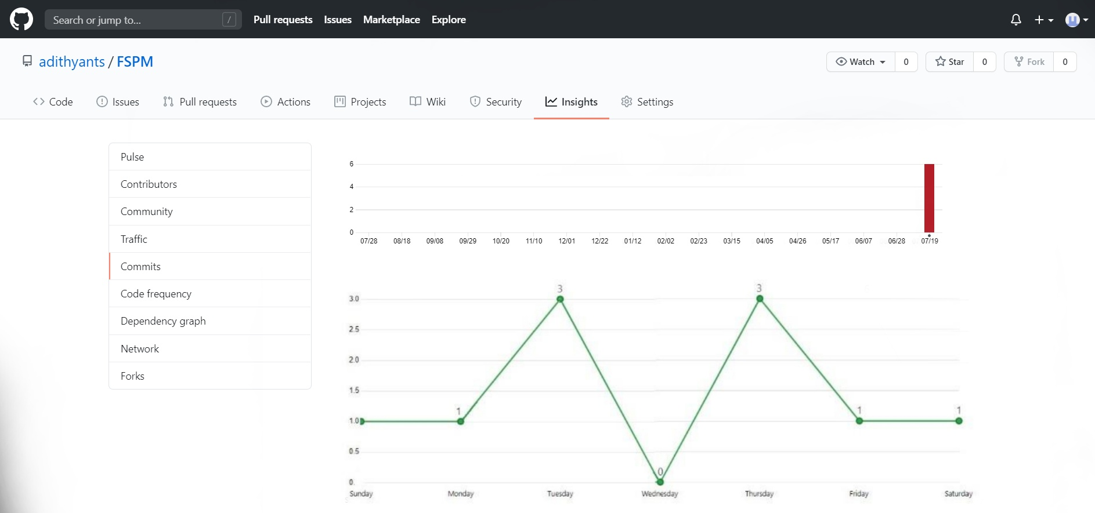

Slide 56
FUTURE ENHANCEMENT
Mobile application for workers/employees
Blockchain and distributed ledger technologies (DLT) projects aim to unite data from a company’s various processes and stakeholders into a universal data structure.Aiming to reduce the complexity and disparities of their siloed databases.When it comes to keeping track of the sourcing of parts and raw materials, blockchain can manage the disparate inflows to a factory. With blockchain, as products change hands across a supply chain from manufacture to sale, the transactions can be documented on a permanent decentralized record — reducing time delays, added costs, and human errors.

Slide 57
CONCLUSION
Thus FSPM software application designed for limitless integration of key inputs from your factory floor and manages the entire system .The system helps to analysis and predict machine efficiency, spare efficiency and overall management
It helps to
> Eliminate unplanned downtime
> Prevent bottlenecks in the manufacturing process
> Operate with near 100% machine utilization
> Optimize scheduling and resource allocation
> Have complete unimpaired visibility and traceability of the entire manufacturing process
> generate report regarding machine efficiency and spare efficiency

Slide 58
REFERENCE
Books
Kenneth.S.Rubin, Essential Scrum: A Practical Guide to the Most Popular Agile Process, First Edition
Allen B. Downey Think Python: An Introduction to Software Design, Second Edition
Geeta kumari, Neha Kaleramna and K.M. Pandey(1015), ‘study on Performance management system of private companies: a case study of endurance Pvt.Ltd
Website
https://www.javatpoint.com/python-tutorial
https://www.tutorialspoint.com/python/index.html
https://www.tutorialspoint.com/mysql/mysql-introduction.html
https;//www.tutorialspoint.com/Django_creating_project.html

Slide 59
THANK YOU

